Slide 1

Learning By Doing:
Redesigning the First Year Information Literacy Programme at WIT Libraries
Nora Hegarty & Alan Carbery, WIT Libraries

Slide 2

Introduction
Redesigned First Year Information Literacy Programme
– Pilot: 2007
– Full Integration: 2008/2009 & 2009/2010
“What the student does is more important in determining what is learned than what the teacher does”
Shuell, 1986, 429

Slide 3
In the Beginning
Information literacy programmes offered in WIT Libraries since the late 1990s
First Year Information Literacy Programme: 2 hour lecture-demonstration model
Overall aims
- Successful transition to 3rd level education
- Comfortable, confident, competent library users

Slide 4
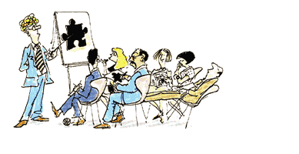
Sage on the Stage
Behaviourist model
Teacher-centred approach
Librarian as expert, students as ‘empty vessels’
‘Show & tell’ or ‘point & click’ approach
Passive & rote learning

Slide 5
Learning by Doing
“Learning is not a spectator sport. Students do not learn much just by sitting in classes listening to teachers, memorizing pre-packaged assignments, and spitting out answers. They must talk about what they are learning, write about it, relate it to past experiences and apply it to their daily lives. They must make what they learn part of themselves” Chickering & Gamson, 1987, 5

Slide 6
Student-Centred Approach
“If transportation may be likened to
learning, the goal of education is
not to move learners passively from
point to point but to help them
learn to drive themselves”
Gunderman & Wood, 2004, 897
Decision to redesign First Year Information Literacy Programme around these principles
Variable influences

Slide 7
Influences
“Learning is an active process and the Institute is committed to ensuring that the learner is at the centre of the learning experience”
WIT Strategic Plan 2007-2010, 2007, 45
“Great teachers stimulate active not passive learning and encourage students to be critical, creative thinkers with the capacity to go on learning after their college days are over”
Boyer, 1997, 23

Slide 8
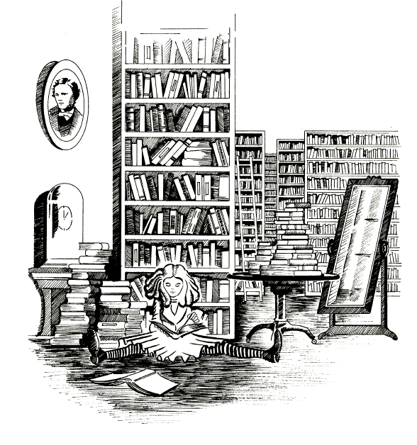
Students
“What is the use of a book”,
thought Alice, “without pictures
and conversations?”
Millennials
  Entertainment & interactivity
  Peer-based learning & multi-tasking
  IAKT syndrome (Bell, 2007)
International students
Mature students
  Self-directed, task and problem-centred approach

Slide 9
The Workshop Approach
2 hour lecture-demonstration model divided into
2 x 1 hour workshops
Introduction to the Library
  Print resources & library OPAC
Introduction to Electronic Resources
  Research databases & web resources
  Evaluation & critical thinking

Slide 10
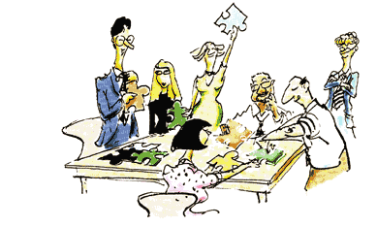
Guide on the Side
Constructivist model
Librarian as facilitator & collaborator & coach
Guiding & scaffolding the learner
Student-centred, mutual inquiry & dialogue
Self-directed, task & problem centred approach

Slide 11



The Worksheet Approach
Engaging learning objects for all aspects of the Programme
Problem-centred activities
Subject-specific
Themes of popular culture

Slide 12
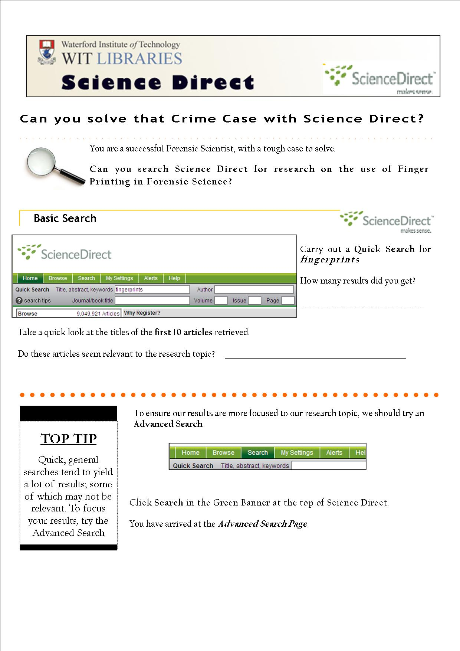
Workflow of Database Worksheet:
Sets the narrative
Starts the user with the Basic Search
Demonstrates the implications of broad keyword searches and the impact on results lists

Slide 14
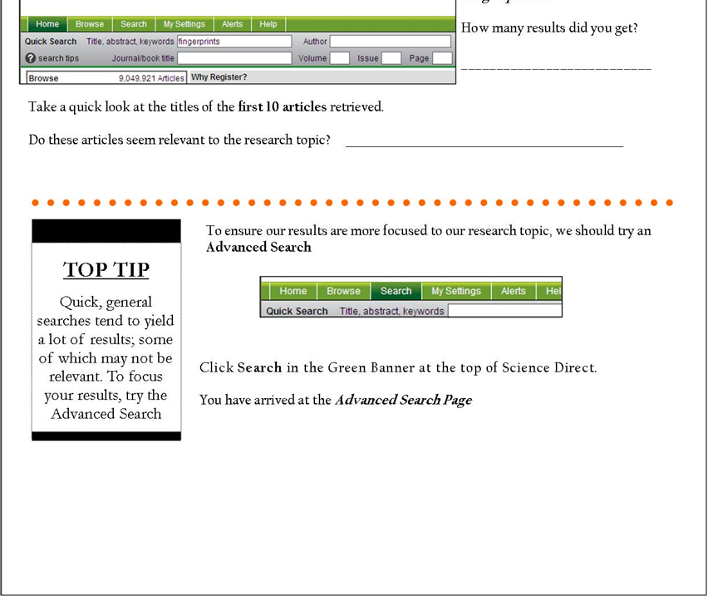

Slide 15
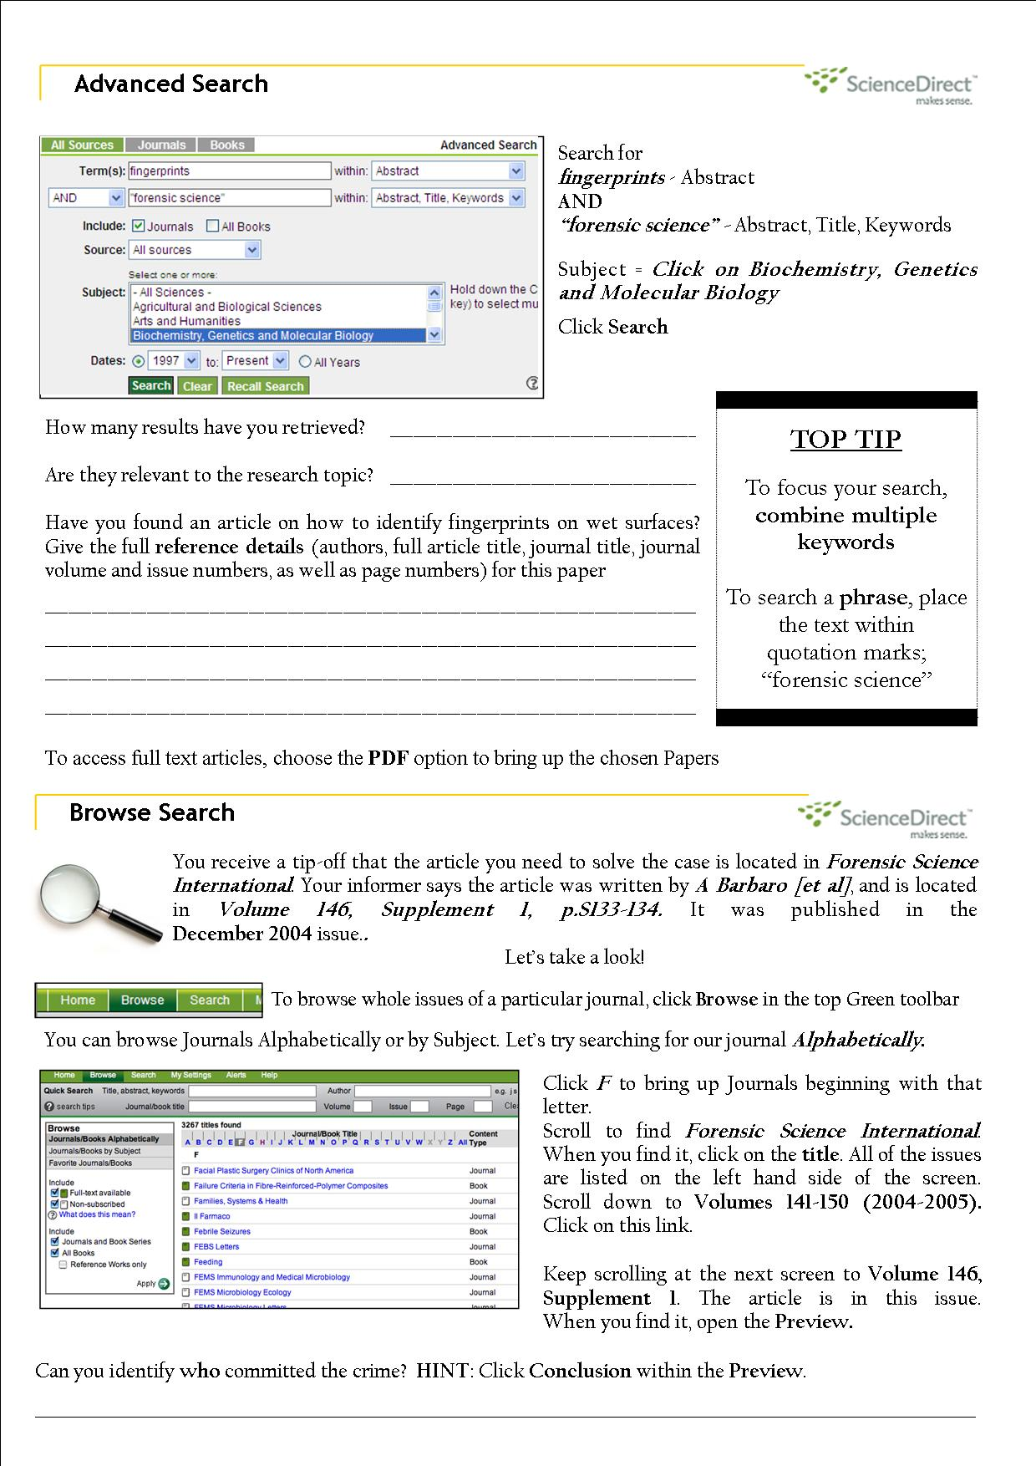
Progresses to an Advanced Search, demonstrating the benefits of Boolean and multiple keyword searching
Moves to Browse Search, demonstrating an alternative method for accessing journal articles and issues

Slide 16
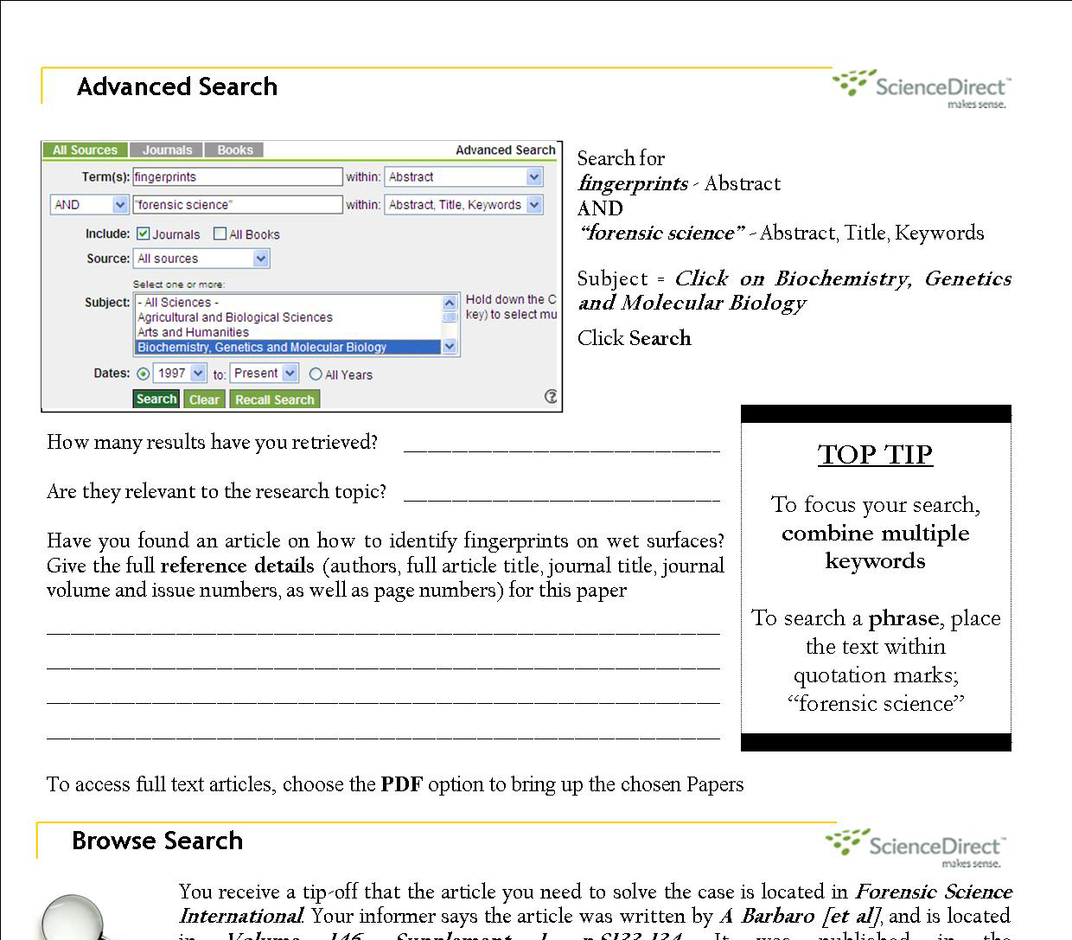

Slide 17
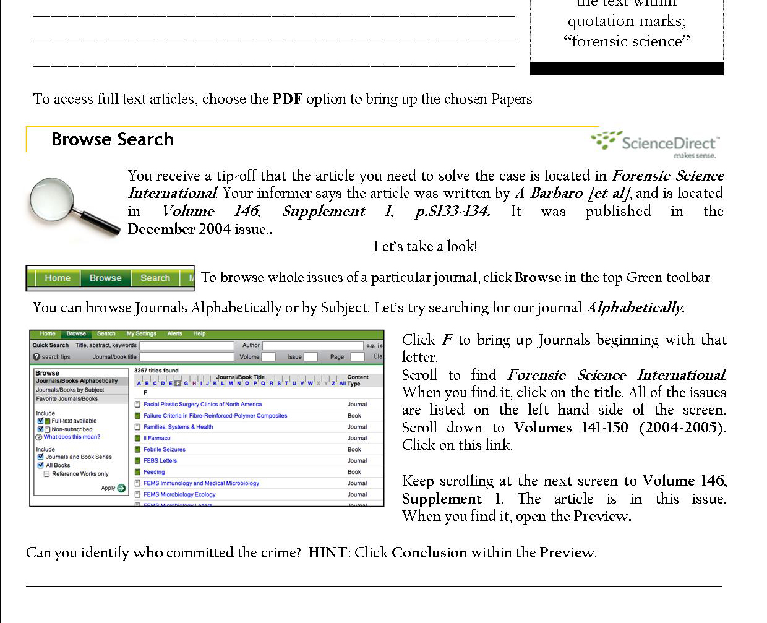

Slide 18
Impact
Evaluation
  Informal & formal
  SIF/WIT co-funded award recognition
Observations:
  Energised & enthused students throughout the sessions
  Reinvigorated Learning Support Team
  Positive & encouraging feedback from teaching faculty

Slide 19
Formal Evaluation (Sept-Dec 2009)
I enjoyed getting involved in the worksheet activities

Slide 20
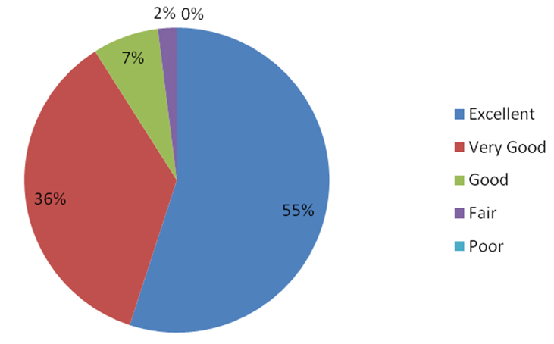
Formal Evaluation (Sept-Dec 2009)
Please Rate the Overall Value of the Library Training Programme

Slide 21
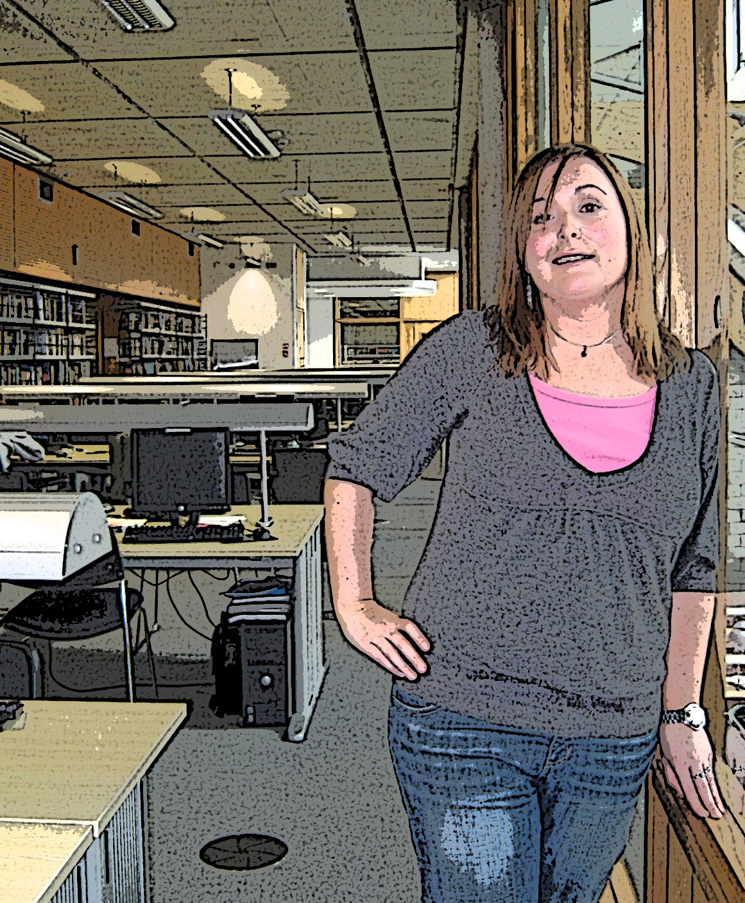
I would recommend library training to future first years
Using the library used to make me nervous. Now I feel confident about using the library
I was unsure of how to search for information. Afterwards, I felt reassured.
The 1st Year
WIT Student

Slide 22
Further Developments
“Students’ information literacy skills should be developed as they progress both horizontally and vertically through the college curriculum” Meyer et al, 2008, 31.
Integrate the student-centred model into all training for undergraduates, postgraduates & staff
Currently developed:
  Nursing undergraduates
  Library staff training

