Slide 1






‘KT Force – towards innovative regions’
RSA Conference, Waterford Institute of Technology
Wed 30th October 2013
Mr. Terry O’Brien, SERA
Dr. Valerie Brett, WIT
Prof. Bill O’Gorman, CEDRE

Slide 2
Agenda
South-East socio-economic
Innovation activity
KTForce Project
KT Force – towards innovative regions
__________________________________
Where we are – scenario 0
What is the project telling us,
- other regions
What we are hoping to achieve
Some conclusions
Notes:
Concentrate on one specific aspect of U-I relations – TT (KT) – how this can contribute to a more innovative region, a more competitive region
A more developed region. Look at an EU project that seeks to make a policy contribution

Slide 3
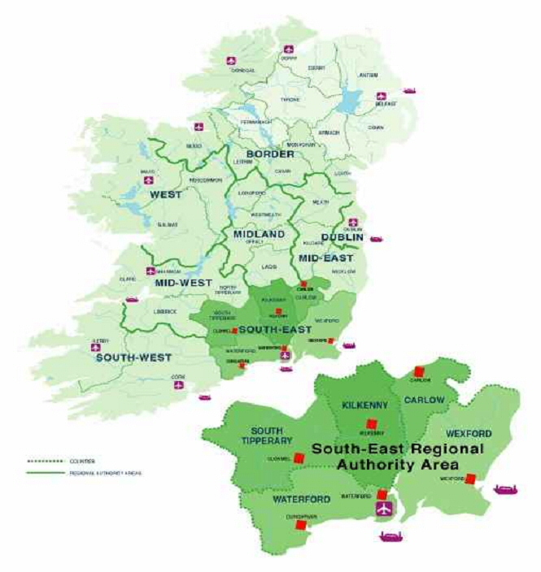
South-East socio-economic
NUTS III region
Population 498,000
Balanced urban structure,
low population density ,
strong rural settlement
Employment
Wholesale & Retail 28,500
Industry 27,200
Health & Social Work 23,200
Agriculture 18,100
Over 35,000+ persons in the Region are employed in State-assisted companies
FDI directly employs 12,000+
Notes:
Pop density 53 per sq. km CSO 2011 – up 8% since 2006; projected to be @ 540,000 by 2016
Reflected in continuing importance of agriculture and increasingly agri related industry
Rural 59%

Slide 4
South-East socio-economic
 | South-East | National
GVA per capita (2012) | 67.4% | 100%
Unemployment rate (2013) | 18.3-19.3% | 14.7-15%
Labour Force participation rate | 58.4% | 60.5%
Rate of growth in unemployment since 2008 | +11.4% | +7.3%
Disposable income per capita | 93.8% | 100%
Notes:
44-45000 unemployed
LT unemployed
Youth unemployment
SW @ 12.9, Dublin 12.9, Border 17.7

Slide 5
Socio-economic Regional Profile
Area of region | 9,406 (13.5% of the State)
Population | 511,000
Population density (persons per sq. km.) | 53
Urban v Rural Population | 45% v 55%
Working age (15-64) | 331,000
Labour Force | 224,000
Labour Force participation rate | 57.5%
Numbers in employment | 181,800
Numbers unemployed | 42,100
Unemployment rate (State = 13.7%) | 19%
Total GVA per capita (State = 100) | 68.3%
Disposable income per capita (State = 100) | 92.9% (€18,215 v €19,318)
IDA assisted companies in the region (FDI) | 70
Notes:
18215 NUTS III v 19910 NUTS II

Slide 6
South-East socio-economic
Some other key statistics for the South-East
Educational attainment in South-East at 23.5% some 5% behind State average and c.12/13% behind Dublin
HERD 1.6% of national total
BERD 4.4% of national total
Source: Forfás Regional Competitiveness Agendas (2009)
Manufacturing Employment by TECHNOLOGY sector
High Technology | 19%
Medium-high Technology | 18%
Medium-low Technology | 22%
Low Technology | 41%
 | Source: CSO NACE statistics (2012)

Slide 7
Regional Labour Markets Bulletin (EGFSN, 2013)
South-East regional workforce comprises:
Public sector employment (25%)
Industry (17%)
wholesale/retail (15%)
High value added sectors [professional,financial,IT] (9% )
High dependency on SME and microenterprise activity in the region
19,000 active enterprises outside agriculture and the public sector; 92% of which employ fewer than 10 persons, and 1% employing 250+ persons.
Significant and continuing decline in active enterprises since 2007, with over 2,000 closures from 2007-2010
Notes:
50,000Industry (highest share in agriculture)
, and a large proportion of these in the construction industry.

Slide 8
Innovation activities
Non R&D innovation expenditure as % of turnover
Venture capital (early stage, expansion and replacement) as % of GDP
SMEs introducing marketing or organisational innovation as % of SMEs
SMEs introducing product or process innovation as % of SMEs
SMEs innovating in-house as % of SMEs
Innovative SMEs collaborating with others as % of SMEs
License and patent revenues from aboard as % of GDP
Percentage population aged 30-34 having completed tertiary education
New doctorate graduates (ISECD 6) per 1000 population aged 25-34
Public R&D expenditure as % of GDP
Sales of new market and new o firm innovations as % turnover
The ECs new ‘Indicator of Innovation Output’ places Ireland 3rd in the EU getting the most out of innovation – ranking it as a ‘top performer’ with a score of 124.8, well above the EU average.
Notes:
Action Plan for Jobs is better using our research and innovation budget to drive job creation,” Bruton said.
“Turning good ideas into good jobs” – at political level called

Slide 9
Aggregate levels of BERD (2011) – Some data
(BERD 2011 / 2012 Forfás)
Enterprises across all business sectors in Ireland spent €1.86 billion on in-house
research and development (R&D) activities in 2011, a 1.3% increase on 2010.
Enterprises active in R&D in 2011 estimated an R&D spend of 1.96 billion in 2012, an
increase of 5.5%
Business R&D intensity (BERD as a percentage of GDP) reached 1.17% in 2011
Foreign owned enterprises accounted for 71% of the total business R&D spend in 2011.
The vast majority of expenditure on R&D by businesses (86%) in 2011 was
current expenditure (wages of R&D staff etc.) and 14%on capital expenditure
(e.g. buildings, equipment, licence payments etc.)
61% of BERD was generated in the services sector in 2011.
More than half of R&D personnel (headcount) were employed in foreign owned firms.
The majority of R&D personnel (63%) were employed in the services sector.
Medium to large companies employed two thirds of all research personnel.

Slide 10
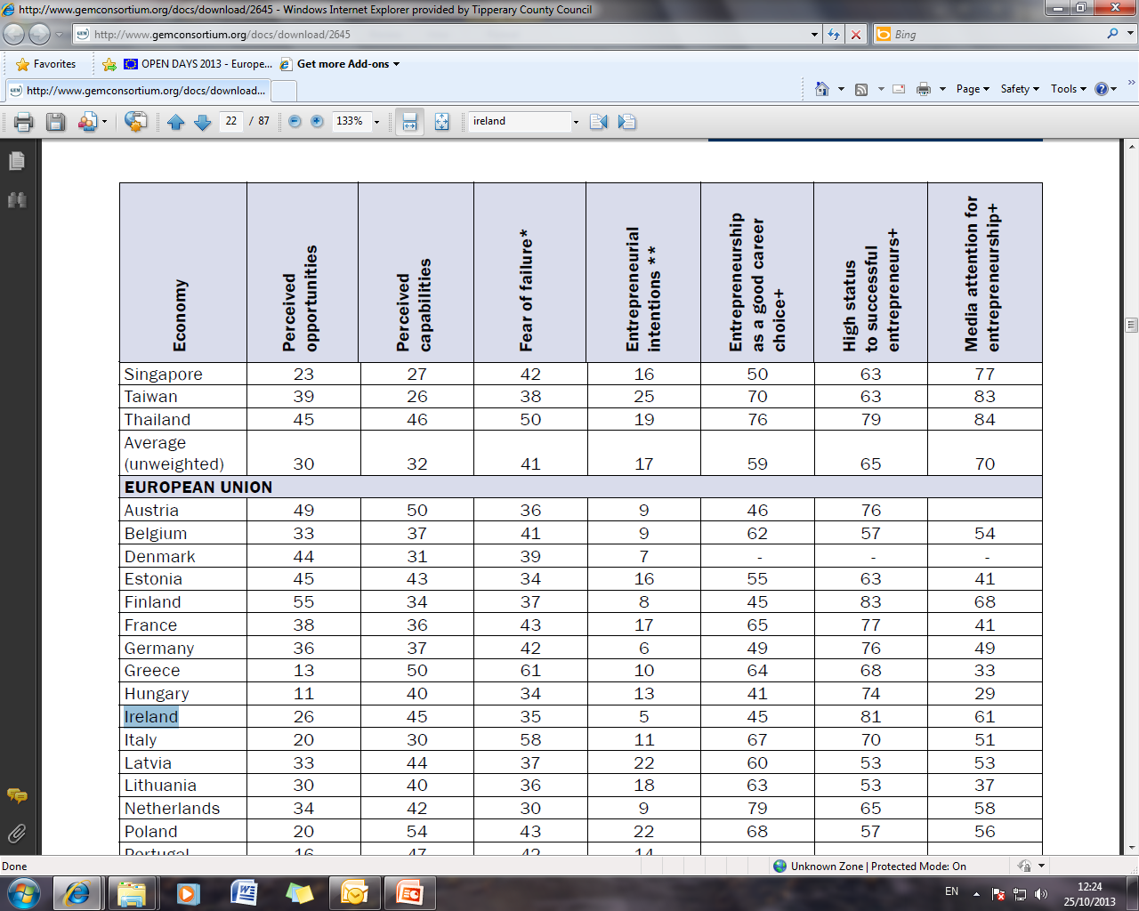
Innovation Activity
Categorised by GEM 2012 as an Innovation driven economy
Entrepreneurial Attitudes and Perceptions, GEM 2012

Slide 11
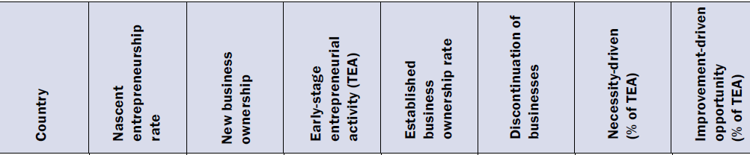
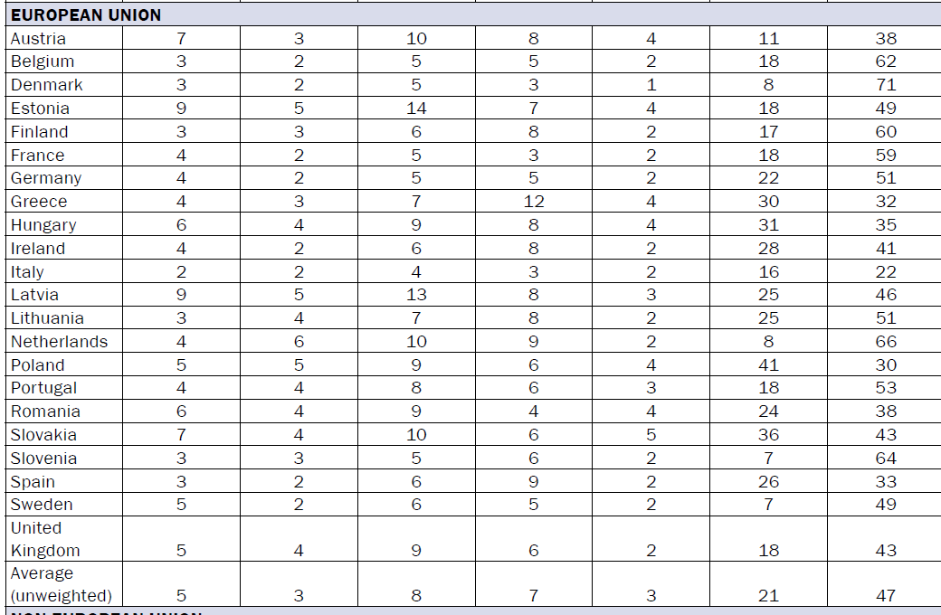
A Global perspective on entrepreneurship 2012 – the EU
Notes:
Total early stage entrepreneurial activity
NUTS II v NUTS III

Slide 12
According to Forfás (2005) report, Ireland requires ‘catching up’ .....
policies for absorptive capacity development, on the one hand, and must improve links with higher education, on the other.
“were poor and relationships often characterised by mistrust”
(Forfás, 2005, p. iii)
Technology transfer
Acknowledgement of need to improve technology transfer
Specific focus “on the transfers being affected by interaction between the Third Level Sector (TLS) and industry.”
Interactions involving the SME sector very low:
“stated from the industry/venture capital side that TLI expectations are unrealistic. For example, there is often an expectation by the TLI of a 15% equity undiluted in a spin-off company and the reversion of licenses in the event of company failure. Many venture capitalists view these demands as prohibitive.”
Other inhibitive factors include
• Underdeveloped technologies.
• Unreasonable licensing terms.
• Complexity / bureaucracy.
In Europe, knowledge and technology transfer between
university and industry is still
“a missing link in the innovation value chain”
Next generation innovation policy: The future of EU innovation policy to support market growth (Ernst & Young, 2012)

Slide 13
Progress?
- Establishment of TTO Network
- TT strengthening initiatives
- Licensing, spin-outs from Publicly funded Research
“radically enhance the culture of commercialisation among researchers in the Irish HEI sector”
(Inventions & Innovations; the positive impact of ideas from research on Irish industry and society, Enterprise Ireland, 2011)
“a well-identified and long-standing cultural mismatch between the SME sector and the TLI/University sector”
(Kavanagh, P., Maguire, A., Casey, J.:Giving It Away : Free Technology Transfer to the Irish SME Sector. Research Management Review, Vol.15, 1 - Winter/Spring 2006)
Enterprise Ireland, Support to HPSUs
- EI-HEI relationship
- Policy framework
- Commercialisation initiatives e.g. InterTrade
- Intellectual Property Protocol
Minister for Research & Innovation
Technology Gateways (Oct’ 2013)

Slide 14
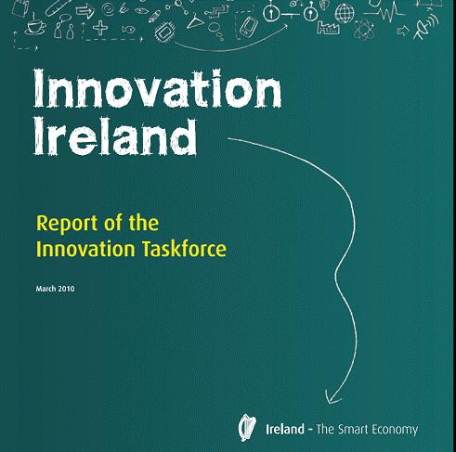

Knowledge Transfer
- Significant policy issue
- A key priority of Innovation Ireland, the report of the Innovation Taskforce
- Actions to improve the linkages between HEIs and industry
- Further incentivise innovation within HEIs and on the need to improve the efficiency and effectiveness of the system for converting IP into commercialised products and services.
- Facilitate optimum knowledge transfer between HEIs and industry
- Fast-track the access by entrepreneurs, existing companies and start-ups to HEI IP, establish and implement a National Intellectual Property (IP) Protocol.
Notes:
as a result of the economic downturn and the need to capitalise on the large public investment in research in the third level sector since 1998 with a view to creating job opportunities.
Return of P

Slide 15
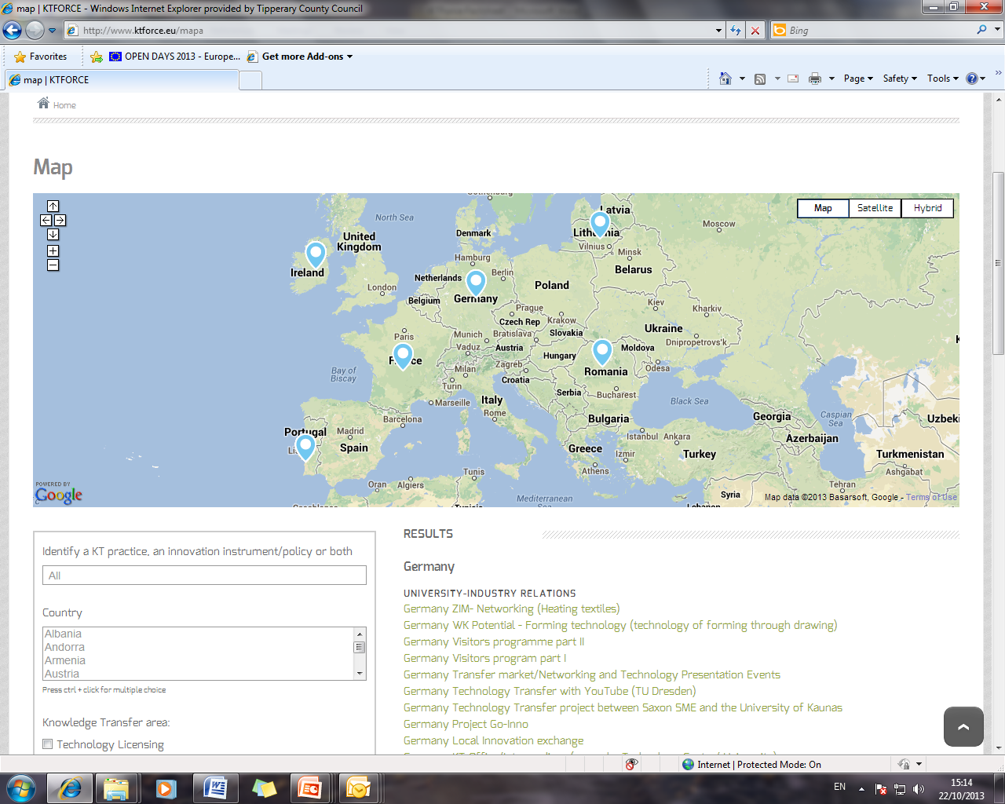
KT Force – Knowledge as a value
“Knowledge Transfer and Efficient Innovation Policies”
An INTERREG IVC part EU-funded project under
Priority 1: Innovation and the knowledge economy; Sub-theme: Innovation, research and technology development
11 partners in total , Jan 2012- June 2014

Slide 16
Knowledge Transfer recognized by European Union as key tool for boosting innovation
and competitiveness across Europe.
(see ‘Improving knowledge transfer between research institutions
and industry across Europe, European Commission’, 2007)
KTFORCE aims to investigate both innovation policies and knowledge transfer practices in the partner regions, so that a set of strategic recommendations for future design of innovation policies and implementation of KT practices can be applied.
To achieve this, project focuses on 3 key KT areas:
Technology licensing;
Spin-off creation & Entrepreneurship;
University-Industry relations.
KT Force Project

Slide 17
To identify, collect, analyse and disseminate good practices in the field of KT between partner regions and develop policy orientations and approaches to be adopted by and applied in the other European regions
To improve practices in the 3 KT areas to be implemented at operational level, by analysing the way how each practice was implemented by the partners, their results, and the problems solved
HEI-Industry
Spin-offs, entrepreneurship
Technology licensing
To improve the efficiency of regional/local innovation policies by fostering close collaboration between public authorities and operational KT Offices
To raise exchange levels and foster links between relevant stakeholders in the KT project via a network composed of partners from EU countries bringing into the partnership two key types of entities:
KTOs (operational level) and public regional/local authorities (political level)
To advance recommendations for future policy design able to improve KT processes at regional/local level

Slide 18
Deficiency
Policy is centralised, driven by national government
Policy context and framework is clear, but …
“less clear is role of regional development and in particular imbalances between different regions”,
“ a deficiency in the national innovation policy that should be addressed as a matter of priority”
(BMW Audit of Innovation System, 2011)
Little or no spatial or regional emphasis
“deficient in recognition of role of regions innovation systems as a complement to national innovation system”
No defined or specific policy unique to South East region,
Notes:
Although, policy framework established, regional deficienciess – uniqueness of regions

Slide 19
In practical terms, KTForce proposes:
To map existing policies and practices for KT
To look at existing regional scenario’s and possible future scenario’s
To review the impact innovation policies have on KT practices and the type of policies that would need to be developed in order to meet the challenges and needs of the regions

Slide 20
Mapping of the KT practices and policies in each partner region: (EIRIPM)
Assessment methodology to determine the best practices and policies identified: Categorization of individual variables in the policies into an inventory to select which ones directly impact KT.
Analysis of needs for each region, with the definition of “Scenario 0: Where are we?” and 2 possible “future scenarios” to be reached in a mid-term.
Definition of an implementation plan (and transfer package) of selected practices and policies for each partner region.
Compilation of the best practices and policies identified into an interactive database webtool the “Knowledge Transfer Platform”.
Notes:
1. - which was created by the EC to facilitate access to information on research and innovation policies within Europe and beyond.

Slide 21
KT Force – towards more innovative regions
The main expected result is the
improvement of local and regional innovation policies focusing on KT,
development of an implementation plan of selected policies in each partner region and presented via an interactive database web tool,
the results planned by KT FORCE to positively impact on the definition of innovation policies focusing on Knowledge Transfer in Europe.
Notes:
To define a roadmap and an implementation plan for future policy design and practices development

Slide 22
Scenario 0
Each region’s scenario 0 and the future scenario are based on TFP analysis and innovation indicators from the EU Innovation Scoreboard and Eurostat
Innovation Indicators
Total Factor Productivity
Scenario 0
Where the Region “IS”
The scenario 0 and the future scenarios are based on the analysis of the Total Factor Productivity. Therefore in general practices and policies which affect positively the indicators should be implemented and form the basis of each regions future scenario
Practices and Policies which affect positively
INDCIATORS
TFP and thus the output level and economic growth
The selected indicators are measures that are associated with the areas of focus of the KT Force project namely, technology licensing, spin-off creation and entrepreneurship and university-industry relations.

Slide 23
Innovation Indicator Examples
Sales of new to market and new to firm innovation as a % of turnover
Non R&D innovation expenditure as % of turnover
Knowledge-intensive services exports as % total of service exports
Venture capital (early stage, expansion and replacement) as % of GDP
SMEs introducing marketing or organisational innovation as % of SMEs
Community designs per billion GDP (in PPS€)
SMEs introducing product or process innovation as % of SMEs
Medium and high-tech products as a % total of products exports
SMEs innovating in-house as % of SMEs
Innovative SMEs collaborating with others as % of SMEs
PCT patent applications per billion GDP (in PPS€)
PCT patent applications in societal challenges per billion (in PPS€)
Percentage youth aged 20-24 having attained at least upper secondary level education
License and patent revenues from aboard as % of GDP
Community trademarks per billion GDP (in PPS€)
Percentage population aged 30-34 having completed tertiary education
New doctorate graduates (ISECD 6) per 1000 population aged 25-34
Public R&D expenditure as % of GDP
Sales of new market and new o firm innovations as % turnover
Notes:
The selected indicators are measures that are associated with the areas of focus of the KT Force project namely, technology licensing, spin-off creation and entrepreneurship and university-industry relations.

Slide 24
Total Factor Productivity
Total-Factor Productivity (TFP)is a variable which accounts for effects in total output (GDP) which is not caused by traditionally measured inputs.
Traditional inputs are physical capital (machinery) and labour (the employees or workers). If all inputs are accounted for, then TFP can be taken as a measure of an economy’s technological change, or technological dynamism or productivity.
TFP can illustrate the degree of technological knowledge and degree of human capital;
Technological knowledge corresponds to more eﬃcient production techniques, better institutional and organizational arrangements (i.e. the more eﬃcient use of the current level of inputs and technology).
(2) Human capital is obtained when individuals improve their own skills in response to incentives, which increase the aggregate productivity; i.e. the TFP.

Slide 25
Future Scenarios
Each region’s scenario 0 and the future scenario are based on TFP analysis and innovation indicators
The analysis provides a list of the indicators each region should focus on for the construction of each future scenario (e.g. based on TFP analysis and indicators a region should address via practice implementation or modification in descending order;
(1) Non-R&D innovation expenditures as % of turnover.
(2) SMEs introducing product or process innovations as a % of SMEs.
(3) Medium and high-tech product exports as % of total product exports.
The indicators are also associated with each of the three KT Force themes and the analysis provides instruction on which themes each region should prioritize and which countries perform better.

Slide 26
1
2
3
4
Thus, in Ireland should be implemented practices and policies that affect, by a descending order, indicators 1, 2, 3 and 4 (related with U-I relations)

Slide 27
5
6
7
8
… indicator 5 (related with U-I relations), 6 (related with SO&E) and 7 (related with U-I relations) and 8 (related with licensing practices)

Slide 28
  Indicators that have a More Positive Impact on TFP in Ireland
  (1) Non-R&D innovation expenditures as % of turnover
  (2) SMEs introducing marketing or organisational innovations as % of SMEs
  (3) SMEs innovating in-house as % of SMEs
Thus, in Ireland, practices and policies more connected with U-I relations should be implemented

Slide 29
Indicators that have a More Positive Impact on TFP in Germany
Based on TFP analysis, indicators that should be focused on:
  (1) Non-R&D innovation expenditures as % of turnover
  (2) SMEs introducing product or process innovations as % of SMEs
  (3) Medium and high-tech product exports as % total product exports
    (1) and (2) are affected by University-industry relations, and (3) is affected by Spin-off creation and entrepreneurship;
Thus, in Germany, practices and policies implemented should be connected with U-I relations and SO&E

Slide 30
Indicators that have a More Positive Impact on TFP in France
Based on TFP analysis, indicators that should be focused on:
  (1) SMEs introducing marketing or organisational innovations as % of SMEs
  (2) PCT patents applications per billion GDP (in PPS€)
  (3) PCT patent applications in societal challenges per billion GDP (in PPS€)
  (1) Is affected by U&I and (2) and (3) by technology licensing
Thus, in France, practices and policies should be more connected with U&IR and Licensing relations

Slide 31
Indicators that have a More Positive Impact on TFP in Lithuania
Based on TFP analysis, indicators that should be focused on:
  Percentage youth aged 20-24 having attained at least upper secondary level education
  (2) Non-R&D innovation expenditures as % of turnover
  (3) SMEs innovating in-house as % of SMEs
    (1), (2) and (3) are affected by University-industry relations
Thus, in Lithuania, practices and policies implemented should be more connected with U-I relations

Slide 32
Indicators that have a More Positive Impact on TFP in Portugal
Based on TFP analysis, indicators that should be focused on:
  New doctorate graduates (ISCED 6) per 1000 population aged 25-34
  Percentage population aged 30-34 having completed tertiary education
  Percentage youth aged 20-24 having attained at least upper secondary level education
  Innovative SMEs collaborating with others as % of SMEs
  SMEs introducing product or process innovations as % of SMEs
    affect University-Industry Relations
  PCT patents applications per billion GDP (in PPS€)
  Community trademarks per billion GDP (in PPS€)
    affect Licensing
  Medium and high-tech product exports as % total product exports
    affect Spin-off and Entrepreneurship
Thus, in Portugal, practices and policies implemented should be more connected with U-I relations

Slide 33
KT Force Partners Theme Performance

Slide 34
Implementation Plans
Data based of policies and practices
The planning phase identifies the proposed practices chosen for implementation, why the practice was chosen, the expected outcome, and lead and supporting stakeholders.
Plan measures the progression of the region over a 3 year period and each year the template consists of a re-planning and re-measurement phase.
Post first year analysis, the TFP and the indicator analysis is recalculated to determine if practice and policy development should remain on the current indicator track or if the order and focus of indicators should be altered to address the varying needs of the region as it progress towards the future regional scenario.
Phase 2 is conducted 12 months later and examines the expected outcomes and the actual outcomes that occurred.

Slide 35
Challenges
Resources
Time
Subjectivity

Slide 36

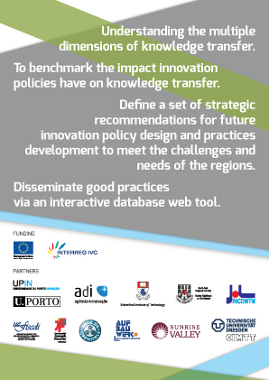
Thank you for your attention

Slide 37
Some further reading
J. Doran, D. Jordan, E. O’Leary (2012): The effects of the frequency of spatially proximate and distant interaction and innovation by Irish SMEs, Entrepreneurship & Regional Development: An International Journal.
DOI: 10.1080/08985626.2012.710261
F. Ruane (2012): Research evidence and policymaking in Ireland, Administration, vol. 60, no. 2, pp. 119-138
Inventions & Innovations; the positive impact of ideas from research on Irish industry and society, Enterprise Ireland, 2011
P. Kavanagh, A. Maguire, J.Casey (2006) :Giving It Away : Free Technology Transfer to the Irish SME Sector. Research Management Review, vol.15, (1) Winter/Spring.
http://www.ktforce.eu

