Slide 1
eBooks .... I’m blaming Ryanair!
Terry O’Brien
CorkPAL Seminar
2nd September 2013
Notes:
Philosophical argument
Record shops, DVDs

Slide 2
“There is no doubt: the era of printed books as the one and only media format for information and knowledge transfer is over. We are witnessing the triumph of digital media and e-books distributed via Internet. Libraries and public libraries in particular are highly challenged by new models of access to digital content. Publishers and distributors provide access via licenses. They don’t sell the material anymore: Licensing has replaced ownership in many cases. Some publishers even refuse to offer digital content to libraries; others have created licensing restrictions which put the traditional role of libraries in modern societies at risk”
IFLA, 2013

Slide 3
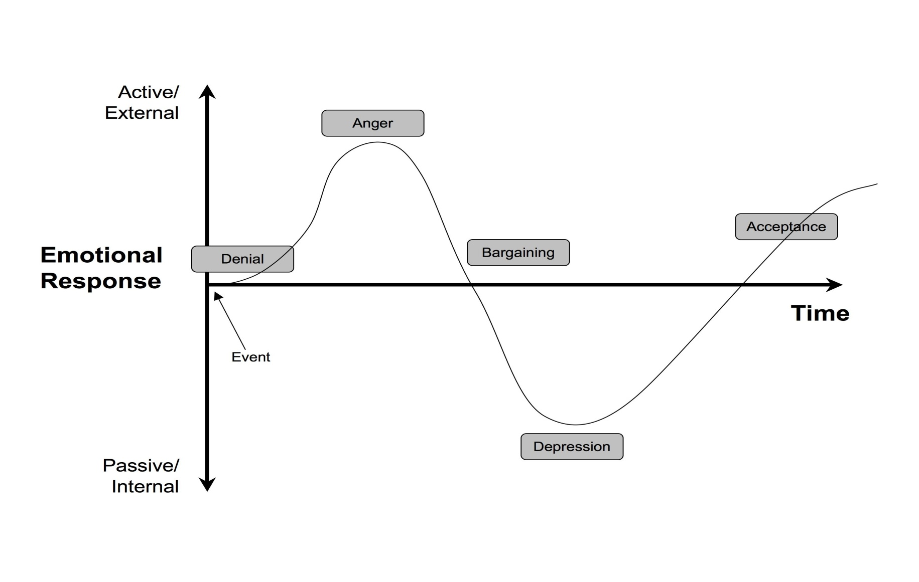
Kubler-Ross Change Curve Model
Notes:
5 stages of grief DABDA
Starts with stability, immobilisatin

Slide 4
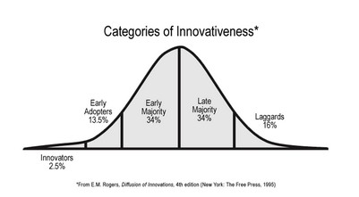
Critical mass
Notes:
The innovation must be widely adopted in order to self-sustain. Within the rate of adoption, there is a point at which an innovation reaches critical mass.
how, why, and at what rate new ideas and technology spread through cultures.

Slide 5
“Without a doubt,
the eBook is practically the
biggest thing that’s hit the
publishing industry since
the invention of movable type” (Philip Ruppel, CEO McGraw-Hill, 2011)
“By the year 2020, 40% of UK research monographs will be available in electronic format only, while a further 50% will be produced in both print and digital. A mere 10% of new titles will be available in print alone by 2020” (British Library)
Notes:
This is probably an underestimation
Change is constant – SHIFT happens

Slide 6
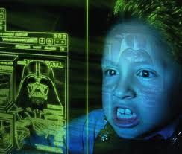
Information Behaviour of the Researcher of the Future (CIBER, UCL)
“Inexorable rise of the eBook”
“A student population hungry for digested content”
“Print sales will fall sharply as electronic publishing matures and consumer demand grows”
“By 2017 eBook will be the default format for textbooks, scholarly books and reference works”

Slide 7
Horizon Reports 2010, 2011
Dramatic upswing
Move to eBooks is compelling “transformative technology”
2010 constraints for academic libraries disappearing
Colour screens and display technologies vastly improved
2011 eBooks now on “near term horizon”
“changing our perception of what it means to read ..new kinds of reading experiences”
“until electronic textbooks are divorced from reader dependant formats, broad adoption will continue to be problematic for universities”
Notes:
Take a look back
Hyperbole, see how things have devloped

Slide 8
Notes:
Barnes & Noble
Rise of streaming models, youtube, iTunes / iTunesU
TV / radio – on demand
Movies – viewing etc.
Increased fees
Huge library cuts
More for less
Library supplier consolidation
Reach of Amazon, Apple, Google
The iPad and the App
The Cloud
Retail damage
Adapt or die, corner book shop

Slide 9
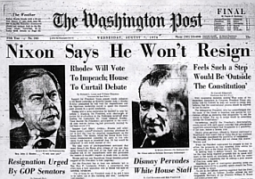
Notes:
Huge decline in print
Jeff Bezos buys WP for just $250m
Hug e sureg in digital content
Paywalls – The Sun, The Irish Times

Slide 10
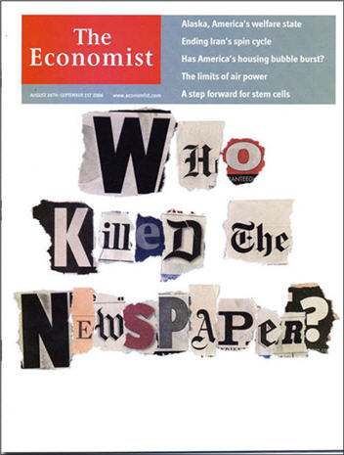
(ABC) figures for newspaper sales in Ireland (Jan-June 2013)
The Irish Times -9 %,
The Irish Independent -3.9 %,
The Irish Examiner -5.8, % The Evening Herald -4.3 %
The Cork Evening Echo -12.3 %
The Sunday Independent -2.6 %, The Sunday World- 6.9 %
Sunday Business Post -6.7 %.
Source:
http://thejournalist.ie/comment/abc-figures-sound-death-knell-irish-print-media/ Posted on Aug 27 2013 - 12:33pm by Ken Phelan
Notes:
show an alarming decrease across all main Irish newspaper titles,
10m digital album sales this year already
iPad sold 3m units in first 80 days
Netflix 23.6m subscribers
Q1 2011 – DVD sales down 20%
Downloading, subscription etc. up 33%
Rise in social media, streaming services
Access not ownership
Kindle, Sony Reader and Nook can now all borrow from libraries

Slide 11
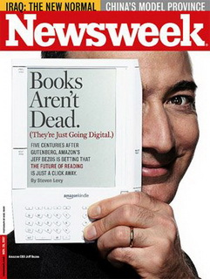
“Device that will change the way readers read, writers write and publishers publish” (2008)
eReader is a game changer “paradigm shifting device”
Sales of eBook and Kindle have reached a “tipping point” (Jeff Bezos, 2011)
Notes:
Transformative technology
"the moment of critical mass, the threshold, the boiling point“
“Ideas and products and messages and behaviors spread like viruses do.“
The Tipping Point: How Little Things Can Make a Big Difference (Malcolm Gladwell, Little Brown, 2000)

Slide 12
1971
Project Guttenberg 1st eBook
2008
Launch of Amazon Kindle eReader
2011
Amazon eBook sales surpass print sales
Notes:
Tipping points
Cost and availability of readers is not longer prohibitive

Slide 13
2007 Release
Xmas 2009 eBooks > Print
July 2010 eBooks > Hbks
Dec 2010 eBooks >Pbks
April 2011 eBooks > all books 105:100
Notes:
Kindle adoption rates phenomenal, growth and revenues
Amazon concentrate on content, devices sold at a loss
Apple concentrate in $ terms on devices, new iterations etc.

Slide 14
BUT WAIT!
Exponential growth of eBooks has stopped!!
Globally, record amounts spent on books in 2012, people reading more than ever, this year will revert to negative growth
Market remains fluid, but signs of stabilisation
“The overall e-book market is still a 90-pound weakling next to the Asiatic elephant of print publishing”
Wired Magazine
Year-on-year sales are down for first time (Nielsen)
Sales of eBooks greater than print books in 2014 – 47m units
“Drop in eBook sales directly attributable to multitasking tablets which are less conducive to book buying and reading than e-readers are” (Nicholas Carr)
Notes:
eBook rates in Ireland growing but market is tiny compared to the UK, where eBook market is bigger than entire Irish book markets combined
Carr – one of the reasons, global recession, spike, rogers innovation diffusion, early adopters and early majority gone

Slide 15
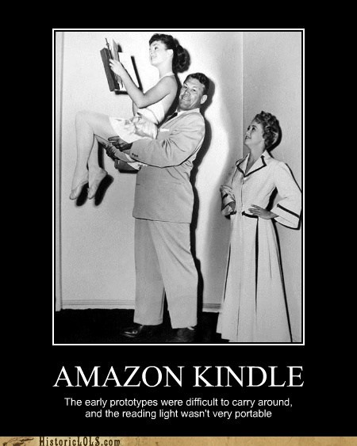
For Amazon, still more e than p
Amazon gone from a bit player to a big player – vertical integration
eBooks tend to concentrate on fiction
Less than 20% of overall book market
Amazon does not disclose metrics
Sales relates to volume not revenue
Only 30% of Amazon book sales are in eBook across all categories
1G Kindle cost $395 stored 2oo books
Current 3G wireless Paperwhite model costs $139, stores 1100 books. You can now buy a Kindle now for under €75
Amazon

Slide 16
Some popular trends
Most popular eBooks are romance, mystery, crime, erotica
Short, quick reads, part of series, read in succession, multiple buys
Amazon customers buy 3.3 times as many books after buying a Kindle
Seasonal buying patterns, post holiday loading
Backlist purchasing and series purchasing popular
Children’s print books remain very strong
Men more likely to buy tablets, women more likely to buy eReaders (Forrester Research (2011)
eBooks for ‘use’ (specific) more than ‘read’ (cover to cover)

Slide 17
Self-publishing
2% of all book purchases
12% of all eBooks
Certain genres +20%
Needs a star performer and ultimately requires traditional channels for very large sales
Trilogy sold 70m copies worldwide
NY Times bestseller list for 50 weeks +
Notes:
caused an 80 percent increase in sales for blindfolds Freakish
contributed to an overall rise in digital and print sales for 2012
The Hunger Games
FiftyShades trilogy an others
Ryan Gosling ...
The rise in the book trade's fortunes was driven by digital developments, with total digital sales up by 66% to £411m in 2012, and total fiction ebook sales up by 149% to £172m, according to figures released by the Publishers Association.

Slide 18
eBooks and eReaders are:
MAINSTREAM
UBIQUITOUS
POPULAR
Notes:
Up to 2011 alone over 8m kindles sold
6m KINDLE fires in q4 2012
Adoption v usageSignificant growth in eBook adoption by libraries is expected in next couple of years
Usage of eBooks is a different issue!
eBooks are no longer a new technology, although the market is evolving quickly
The argument over print versus technology is a philosophical one at this stage
eBooks, eReaders are (very close) mainstream
The consumer market is exacerbating expectations in the academic library sector

Slide 19
User behaviours in academic libraries
Age and gender important
Undergrads and academic staff
Appeals to digital consumers who prefer bite size chunks of information (CIBER)
Men greater users, business students more likely to use
eBooks are not read sequentially “dipping” for ‘use’ (specific) more than ‘read’ (cover to cover)
Convenience factor
Confusion about formats
Log analysis shows power browsing, quick usage
Skimming is endemic
Notes:
What we know about BEHAVIOURS
Postgraduates and researchers veer more towards monographs, conference proceedings, journals
predictors of uptake
Print circulations have not really decreased
Academic mainstream

Slide 20
Primary
Online retailers
Publishers
Secondary
Cost
Tertiary
Students
The Market
Expectation
Technology
Convenience
Accessibility
Changing habits
Librarians
Faculty
Flexible learning
Vendors
Range
Environmental
Space
Notes:
Demand Drivers

Slide 21
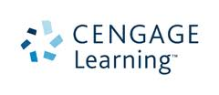
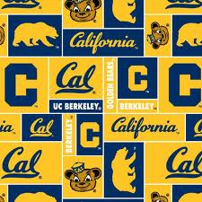
“eTextbooks flunk early test” (2011)
‘2010 survey - students not warming to eBooks’
“eBooks only an important research tool for 13% of 3,000 respondents”
‘students continue to prefer printed books to e-books’
UCL 2011
“students still refer print when it comes to using, reading, absorbing” (Roy,2009)
“Why aren’t eBooks gaining more ground in academic libraries”
(Slater, JWebLib, 2010)
“Kindles yet to woo university users”
“not knowing how or where to find big factor in lack of usage”
“students .. unclear about structure and functionality of eBooks”(Berget, JAL, 2010)
Notes:
Please Nicholas carr!! Who believes that not only is Google making us stupid, but that reading from screens and skimming is turning our collective brains to mush! (The Shallows)
DRM remians a source of frustration for students
California 2011 (2,500 students)
that many undergraduates complain that they have trouble "learning, retaining, and concentrating" when reading from screens.students prefer many of the low tech elements of print and paper
“more research needed to better understand users interactions”, “students understand conventions of print books but (e.g. index)
The most illuminating part of the survey came when respondents were asked to explain their preferences. The answers suggest that while students prefer e-books when they need to search through a book quickly to find a particular fact or passage, they prefer printed books for deep, attentive reading. "E-books divide my attention," said one undergraduate. "Paper ... keeps me focused and away from distractions that may arise from computer usage," said another. "I have some difficulty paying careful attention to long passages on my computer,” said another. "Reading on the computer makes it harder for me to understand the information," said another. Commented a graduate student: "I am a better reader when I have the print copy in front of me."

Slide 22
In academic libraries context, computers remain primary tool for downloading, storing, retrieving
eReaders market aimed mainly at casual reader but publishers are focussing more on getting content to students via eBook model
eReaders represent what students in future will expect - portability, cost-effective, access at any point in time, flexible not static content
The eReader consumer market has exacerbated user expectations but requirements of academic libraries and their users is quite different to the commercial market
Notes:
Refer to tablets, phablets survival of the fittest

Slide 23
What impact on libraries?
Likely that money spent on eBooks will not be in addition to print books but a compliment or replacement. In other words print book budgets will decrease as eBook budgets increase.
Purchase eBooks not for sake of it, but only if quality and demand established
Avoid buying subject collections unless clear metrics or evidence based demand - bulk eBook collections are simply not read or used
Dispense with all multiple copy purchasing unless completely unavoidable
Purchase individual titles
Look at specific suppliers for specialist areas
Develop a hybrid acquisitions approach to books
Mainstream penetration - consumer appetite for digital content consumption growing rapidly
Notes:
MARC records drive usage (Springer), catalogued books are twice as likely to be used (UCL)
Big Deals were a disaster for libs – tying us into to major costs

Slide 24
Digital Rights Management
Sharing, fair use ...
Privacy
Resources
Patron Driven Acquisition
Open Access
Content compatibility
Preservation, curation
Notes:
DRM - Multiple suppliers may mean multiple licensing agreements
Multiple platforms
According to Schuster and Macmillan if too easy to Borrow – turns eBook buyers into eBook borrowers
Amazon (US) allows limited ‘loan’ by owner (purchaser)
‘Kindlegate’ –– hidden aspects of DRM - Amazon retain control of your copy after purchase
SpringerBook – no DRM, allow ILLs, no restrictions on usage, full ownership
Privacy - What every reader should remember is that if your device is connected to a virtual bookshelf (via your Kindle, or Nook, or Kobo account, for instance), every action you make leaves a trail – and can be collected and analyzed
License versus ownership – danger of putting publishers in charge of preservation
Remains major issue and barrier across all library types
What does ownership mean, concept changing for libraries
Strain on cost / resources but we have that anyway
Resources – ARGOS model, our stuff is out back
Patron Driven Acquisition
PDA – realtime, loss of control, metrics, taking users away from the library
Content compatibility across platforms a big problem
Collection development- large and very expensive collections that nobody reads …
Ownership – does it matter
Fees v access v ownership (perpetuity)
Bundles / subject packages = reduced cost but not necc more value or efficiency
Big Deals (journals, stock picks, databases – relevant, use , value, metrics)
Pay per title
Hybrid aproach co-existence

Slide 25
Ownership v Access
“if libraries had the ability to lend eBooks freely .. It would have serious consequences for the commercial world” - Publishers Association
“the resource sharing that we have enjoyed in the world of analogue books is very much in question” (Roy, 2009)
Collection Development / Management
“libraries focusing too much on their collection budgets … investing in the right skills and partnerships is most critical now. The comprehensive and well-crafted collection is no longer an end in itself.” (Hickerson)
Notes:
buying an eBook means buying a license to view a file – so what does this matter, well yes – ongoing costs, preservation

Slide 26
Some models - where do we fit in?
Site licenses for texts
“Content unifying”
Self-publishing
Direct rental
The rise of the App
Legislative change - enforced
Print on demand
Course materials fees
Short loans
Patron Driven Acquisition
Netflix type models
Renting print textbooks
Notes:
Free eBooks, open access, Gutenburg
PonD – on campus and commercially
Chegg – renting print textbooks
for individ text similar to software + rental programs, print on demand across campuses
Proquest – eBrary, SciVerse , EBSCO

Slide 27
“Books are no more threatened by Kindle than stairs by elevators.”
Stephen Fry
Terry O’Brien
Deputy Librarian,
Waterford Institute of Technology
tpobrien100@gmail.com

